Slide 1
A6: NLP with scikit
Tutorial

Slide 2
Overview
To learn to use scikit - machine learning tool for data analysis.
To revisit using visualization to explore the data and use those insights in further analysis.
To learn how to identify patterns through simulation of data.

Slide 3
Prerequisites
Install scikit:
http://scikit-learn.org/stable/install.html
Install matplot:
https://matplotlib.org/users/installing.html
Install numpy, scipy with pip

Slide 4
Machine learning with scikit

Slide 5

Scikit
tools for data mining and data analysis
built on NumPy, SciPy, and matplotlib
http://scikit-learn.org/stable/index.html

Slide 6
Architecture of THE expected system
Visualization
Training data
Feature vectors
Selected features
Estimation Algorithm
Labels
Pipeline
Testing data
Pipeline

Slide 7
Feature extraction
Text feature extraction
http://scikit-learn.org/stable/modules/feature_extraction.html#text-feature-extraction
>>> vectorizer = CountVectorizer()
>>> vectorizer
CountVectorizer(analyzer=...'word', binary=False, decode_error=...'strict',
dtype=<... 'numpy.int64'>, encoding=...'utf-8', input=...'content',
lowercase=True, max_df=1.0, max_features=None, min_df=1,
ngram_range=(1, 1), preprocessor=None, stop_words=None,
strip_accents=None, token_pattern=...'(?u)\\b\\w\\w+\\b',
tokenizer=None, vocabulary=None)

Slide 8
Feature selection
Feature selection is a way to reduce the dimensionality of the feature space
There are a set of methods which help us to keep the more informative features and discard the ones which do not contribute to the system.
PCA, Chi square, mutual information, ANOVA etc.

Slide 9
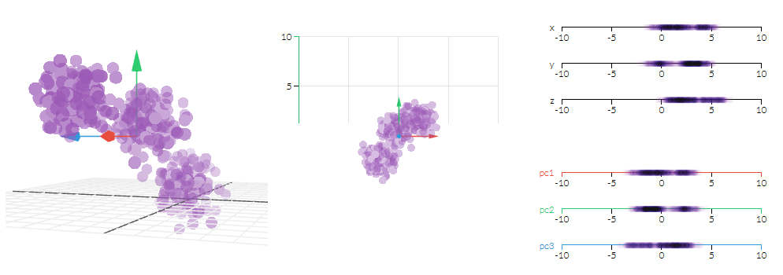
PCA (Principal Component Analysis)
Dimensionality reduction based on eigenvalues and eigenvectors
http://setosa.io/ev/principal-component-analysis/
http://setosa.io/ev/eigenvectors-and-eigenvalues/

Slide 10
PCA in scikit
import numpy as np
from sklearn.decomposition import PCA
X = np.array([[-1, -1], [-2, -1], [-3, -2], [1, 1], [2, 1], [3, 2]])
pca = PCA(n_components=1)
pca.fit(X)
http://scikit-learn.org/stable/modules/generated/sklearn.decomposition.PCA.html#sklearn.decomposition.PCA
Recommendations for the visualisation:
The training dataset is large, and the scatterplot will seem too crowded if al the points are plotted. Instead, randomly select 200-300 samples from each language and plot these.
For this dataset it is ok to randomly select same number of samples because the dataset itself is balanced.
For sparse data use TruncatedSVD

Slide 11
Chi Square
χ² in statistics is measure used for testing the independence between two events.
In ml can be used for feature selection: ranking the features with higher independence between classes.
https://nlp.stanford.edu/IR-book/html/htmledition/feature-selectionchi2-feature-selection-1.html

Slide 12
Chi Square in scikit
from sklearn.feature_selection import SelectKBest, chi2
iris = load_iris()
X, y = iris.data, iris.target
# Select 3 top features
selection = SelectKBest(chi2, k=3)
selection.fit_transform(X, y)

Slide 13
Combining features – feature union
Optional!
Different feature extraction/selection methods can be used.
Scikit allows to easily combine them with FeatureUnion
http://scikit-learn.org/stable/auto_examples/plot_feature_stacker.html#sphx-glr-auto-examples-plot-feature-stacker-py

Slide 14
Logistic regression
Documentation and examples:
http://scikit-learn.org/stable/modules/linear_model.html#logistic-regression

Slide 15
Linear SVM
Documentation and examples:
http://scikit-learn.org/stable/modules/generated/sklearn.svm.LinearSVC.html#sklearn.svm.LinearSVC

Slide 16
Decision trees
Documentation and examples:
http://scikit-learn.org/stable/modules/generated/sklearn.tree.DecisionTreeClassifier.html#sklearn.tree.DecisionTreeClassifier

Slide 17
Naïve Bayes
Multinomial Naïve Bayes:
http://scikit-learn.org/stable/modules/generated/sklearn.naive_bayes.MultinomialNB.html#sklearn.naive_bayes.MultinomialNB
Bernoulli Naïve Bayes:
http://scikit-learn.org/stable/modules/generated/sklearn.naive_bayes.BernoulliNB.html#sklearn.naive_bayes.BernoulliNB

Slide 18
Putting it all together - pipelines
Example:
http://scikit-learn.org/stable/auto_examples/hetero_feature_union.html#sphx-glr-auto-examples-hetero-feature-union-py

Slide 19
Accuracy measure
More information on metrics:
http://scikit-learn.org/stable/modules/model_evaluation.html#model-evaluation
>>> import numpy as np
>>> from sklearn.metrics import accuracy_score
>>> y_pred = [0, 2, 1, 3]
>>> y_true = [0, 1, 2, 3]
>>> accuracy_score(y_true, y_pred)

Slide 20
Confusion matrix
Scikit example:
http://scikit-learn.org/stable/auto_examples/model_selection/plot_confusion_matrix.html

Slide 21
Gridsearch cv with scikit
(OPTIONAL, not mandatory for the assignment completion)

Slide 22
GRIDSearch cv
Documentation and examples:
http://scikit-learn.org/stable/modules/generated/sklearn.model_selection.GridSearchCV.html

Slide 23
Assignment 6 dataset

Slide 24
Dataset from DSL workshop
The dataset can be found on:
https://github.com/Simdiva/DSL-Task/tree/master/data/DSLCC-v2.0
The information can be found on:
http://corporavm.uni-koeln.de/vardial/sharedtask.html
For training use ./train-dev/train.txt
For testing use ./gold/test-gold.txt or ./gold/test-ne-gold.txt

